Slide 1
Mohammad opal CIS 476 Term Project 12/4/2024
Password management software “MyPass”.

Slide 2
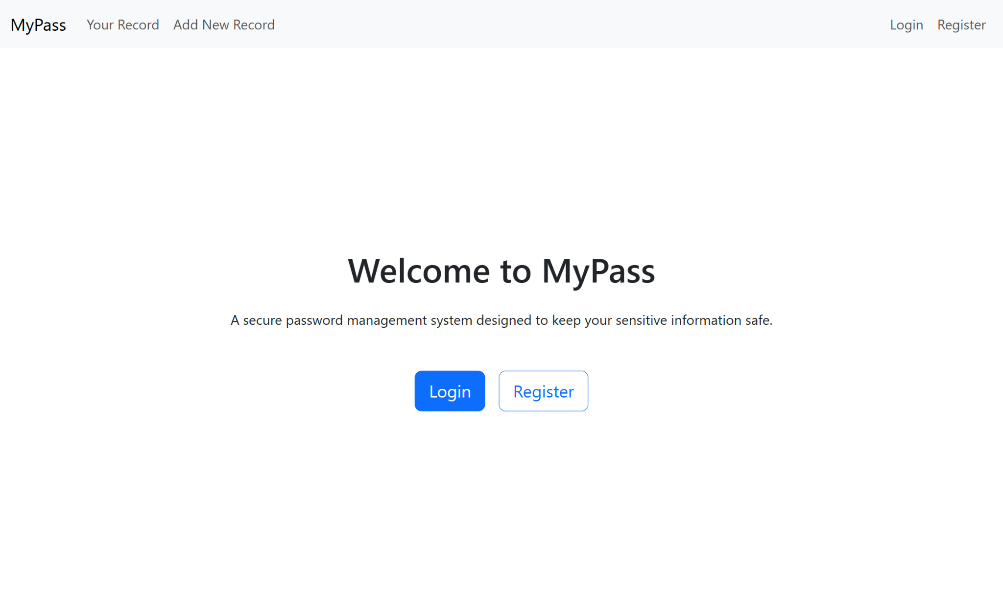
Home page:

Slide 3
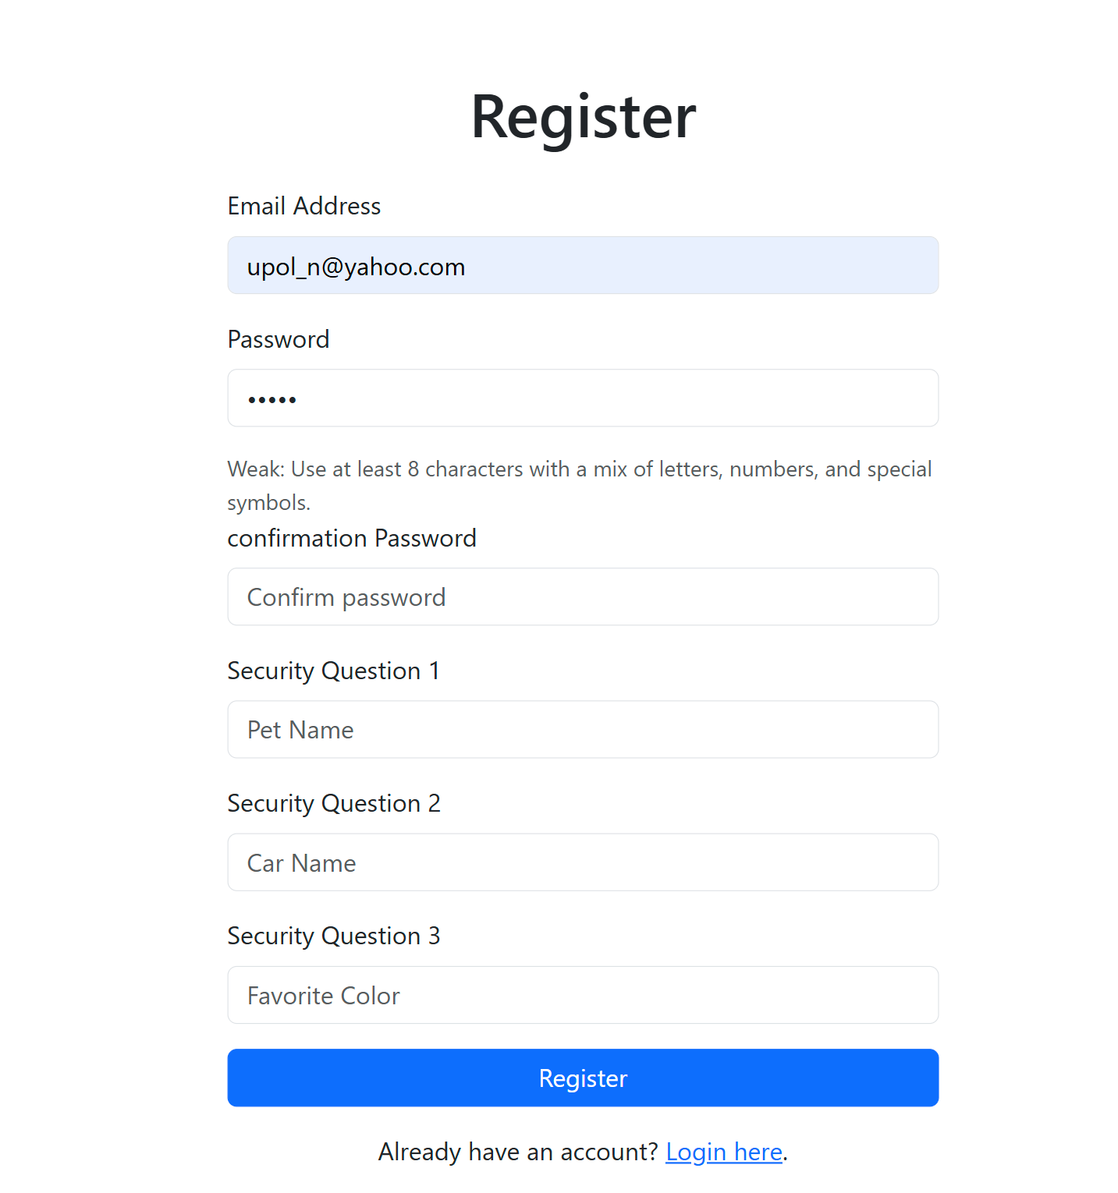
Register: UI:

Slide 4
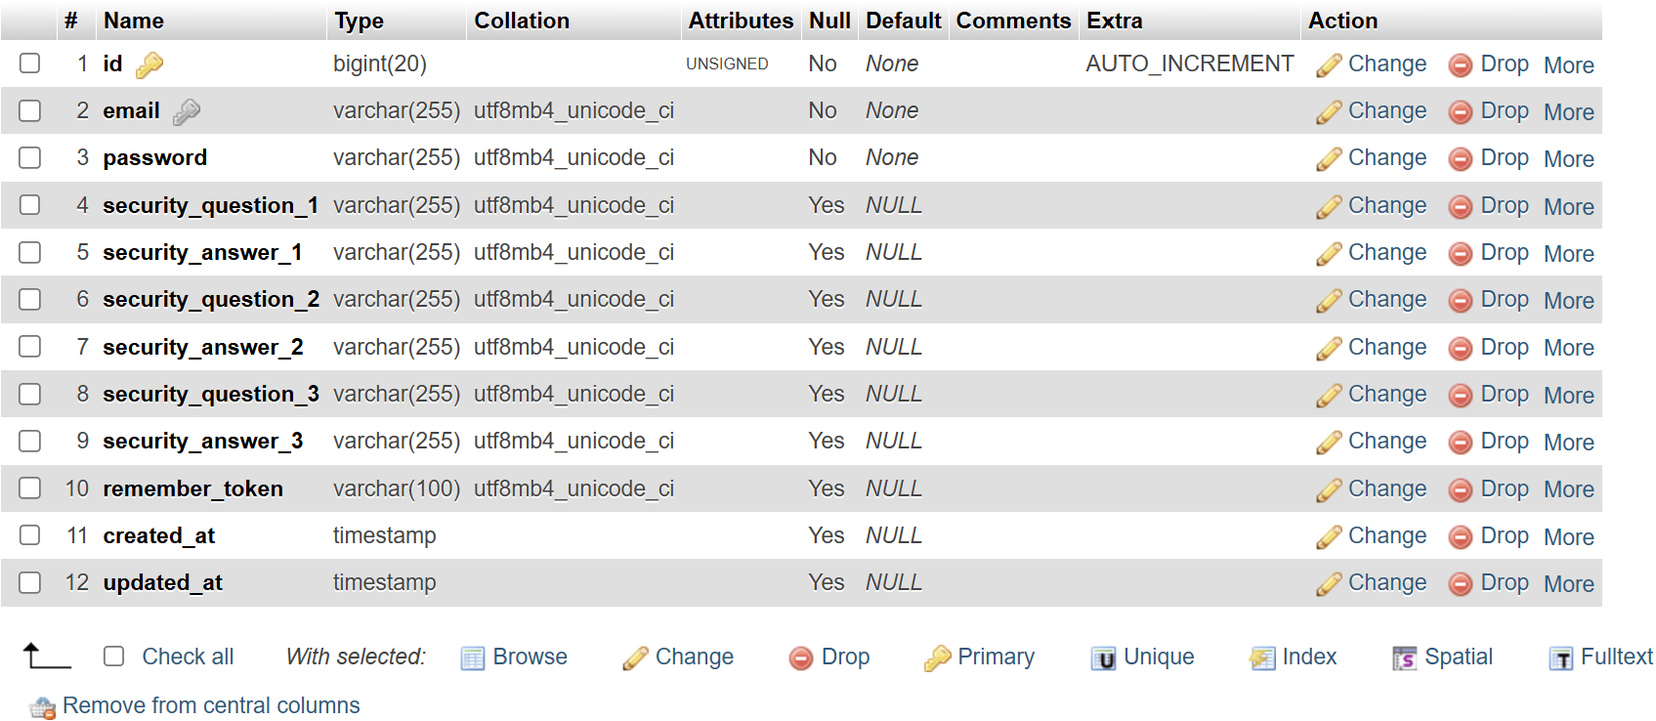
User Table Structure:

Slide 5
User Data Table:

Slide 6
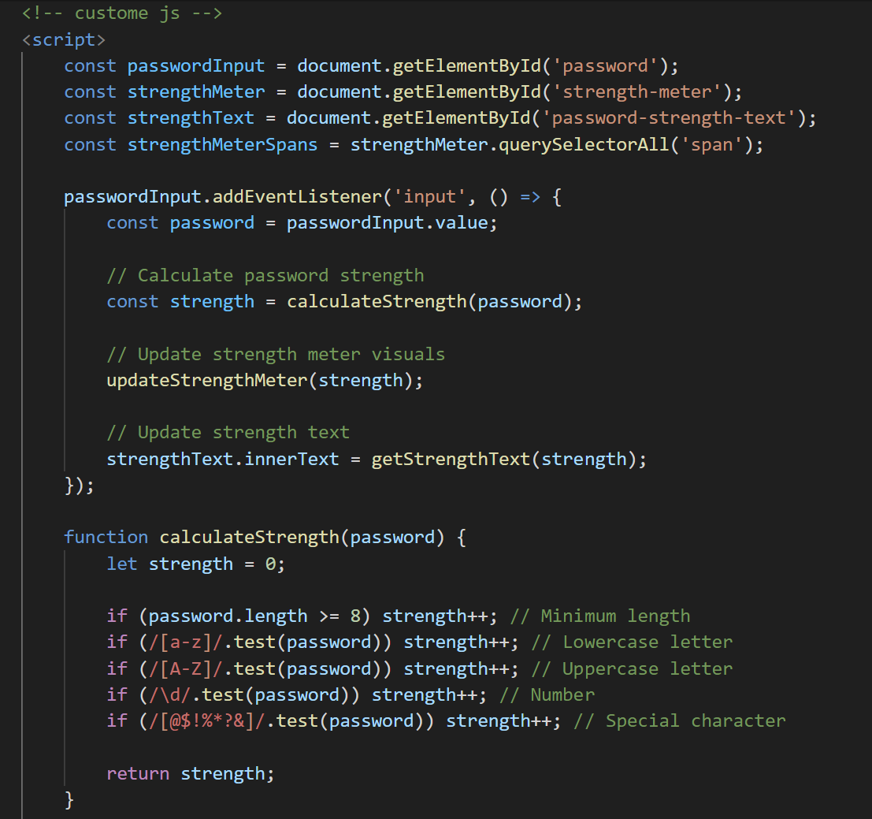
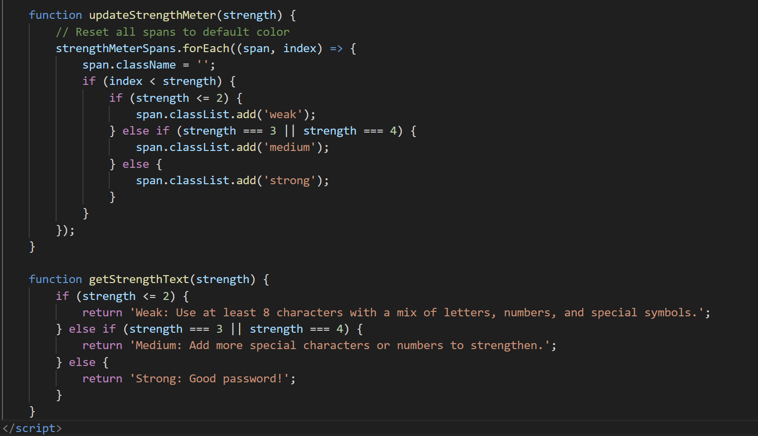
Password pattern: using javascript

Slide 7
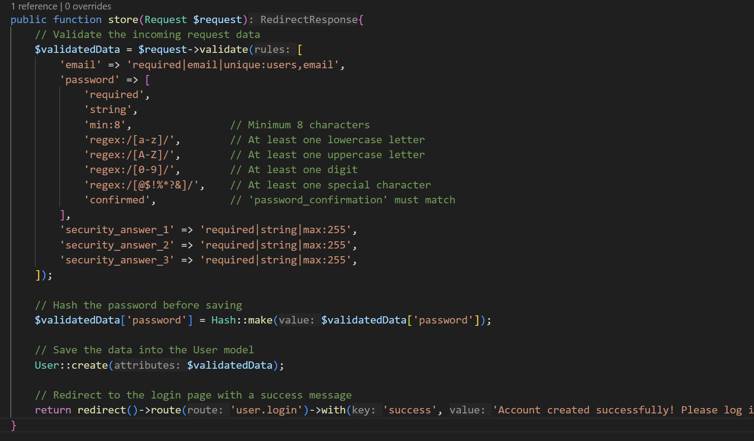
PHP Code:

Slide 8
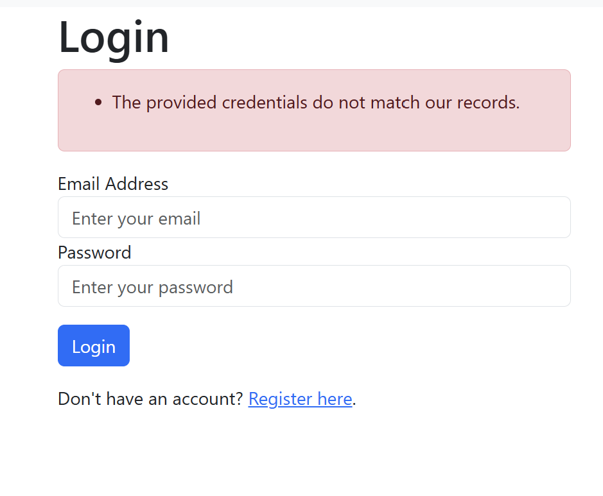
Login:

Slide 9
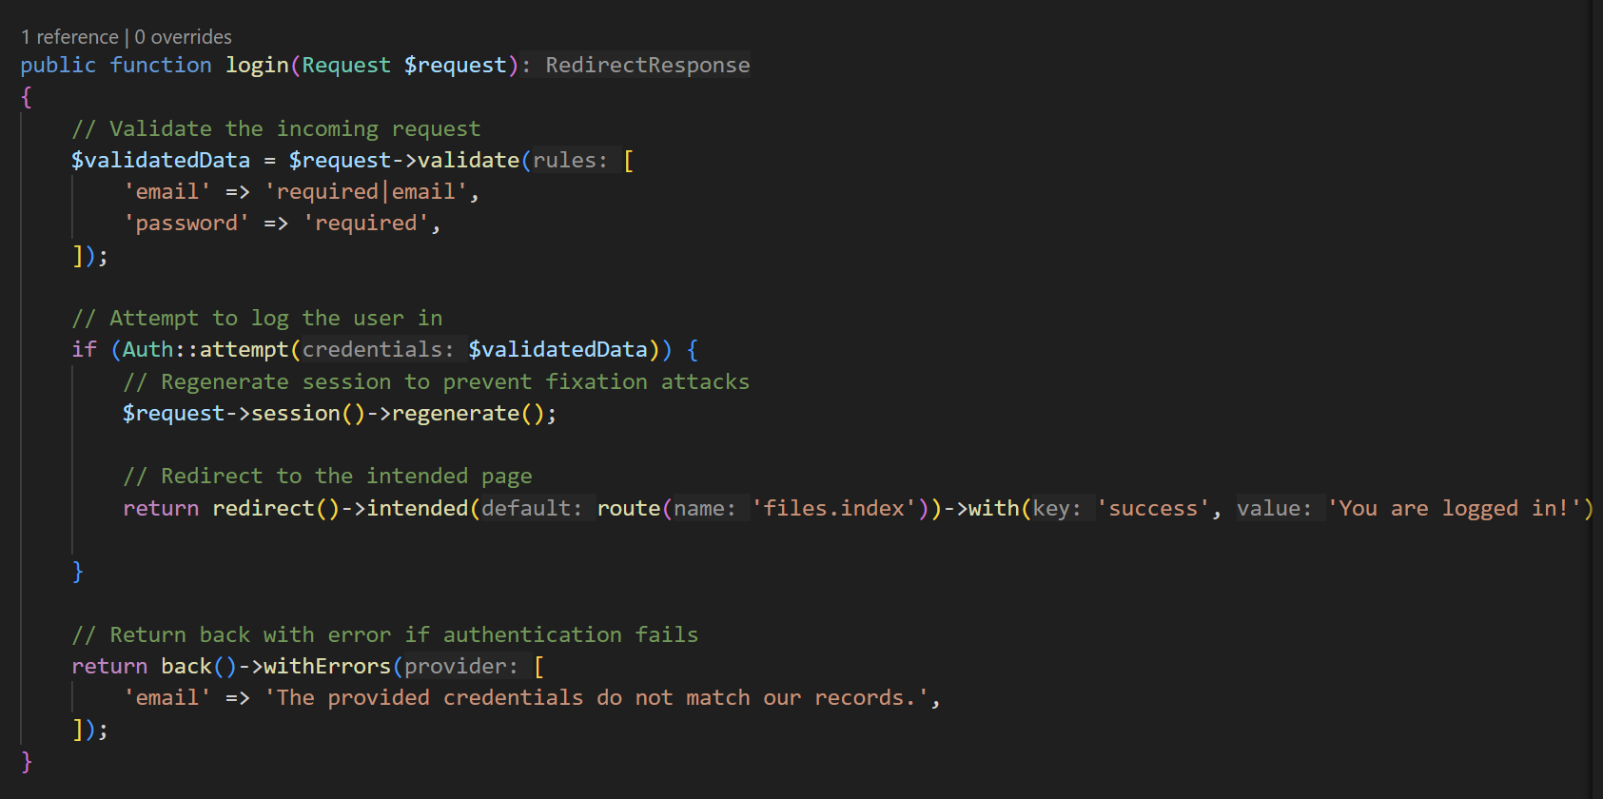
Source code:

Slide 10
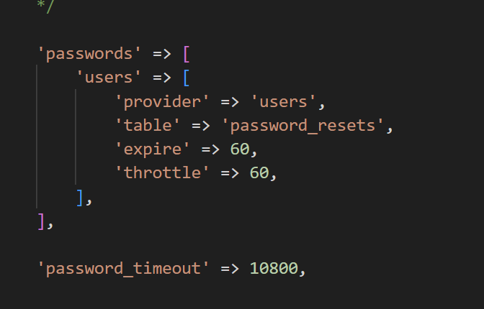
Login timeout:

Slide 11
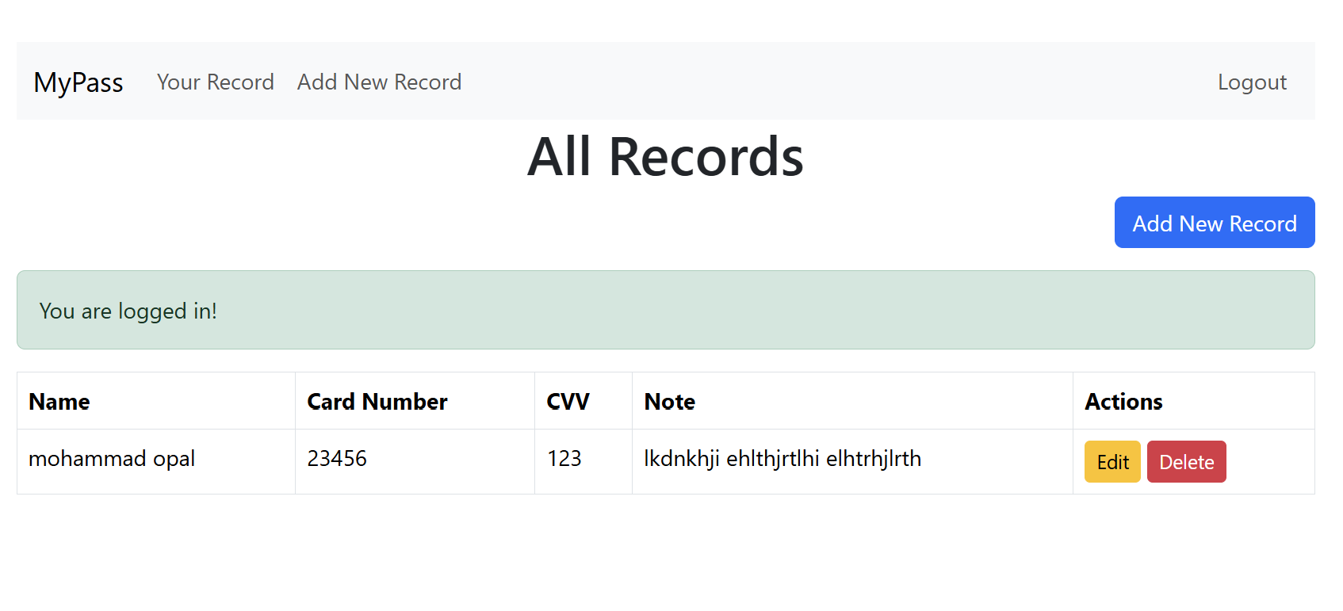
Data List:

Slide 12
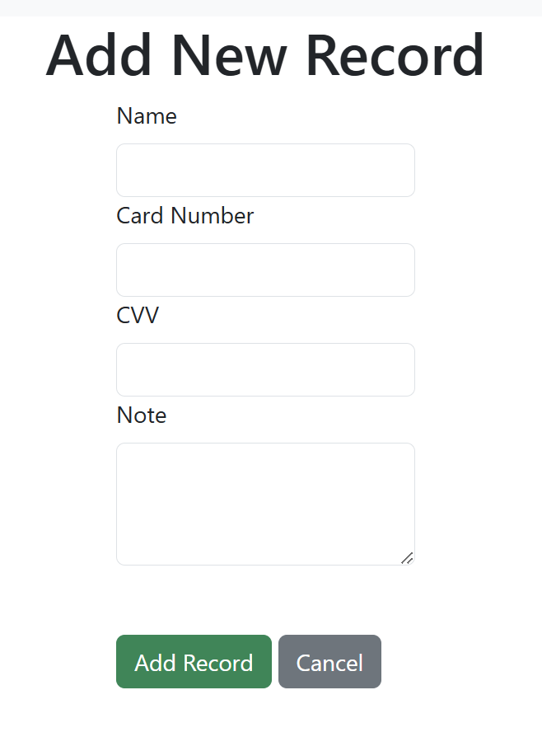
Add Data:

Slide 13
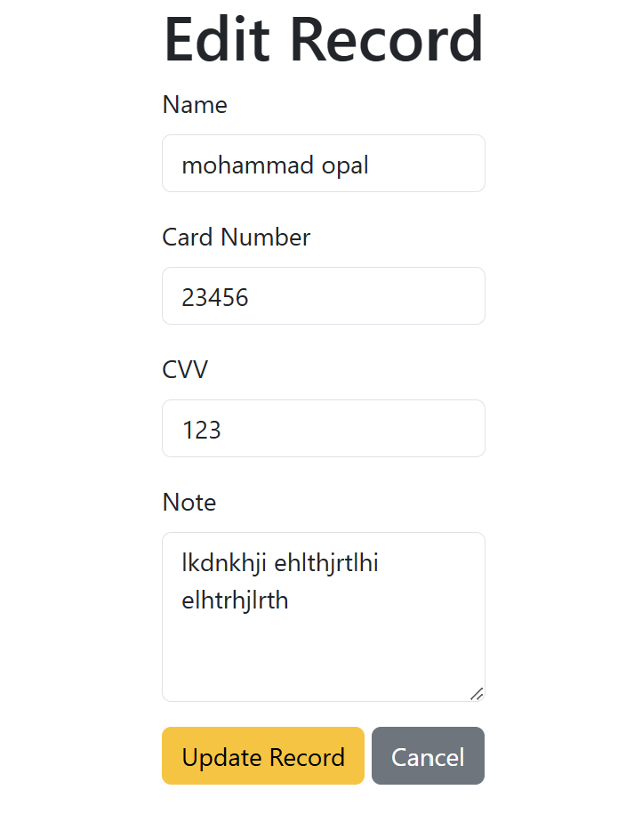
Edit data:

Slide 14
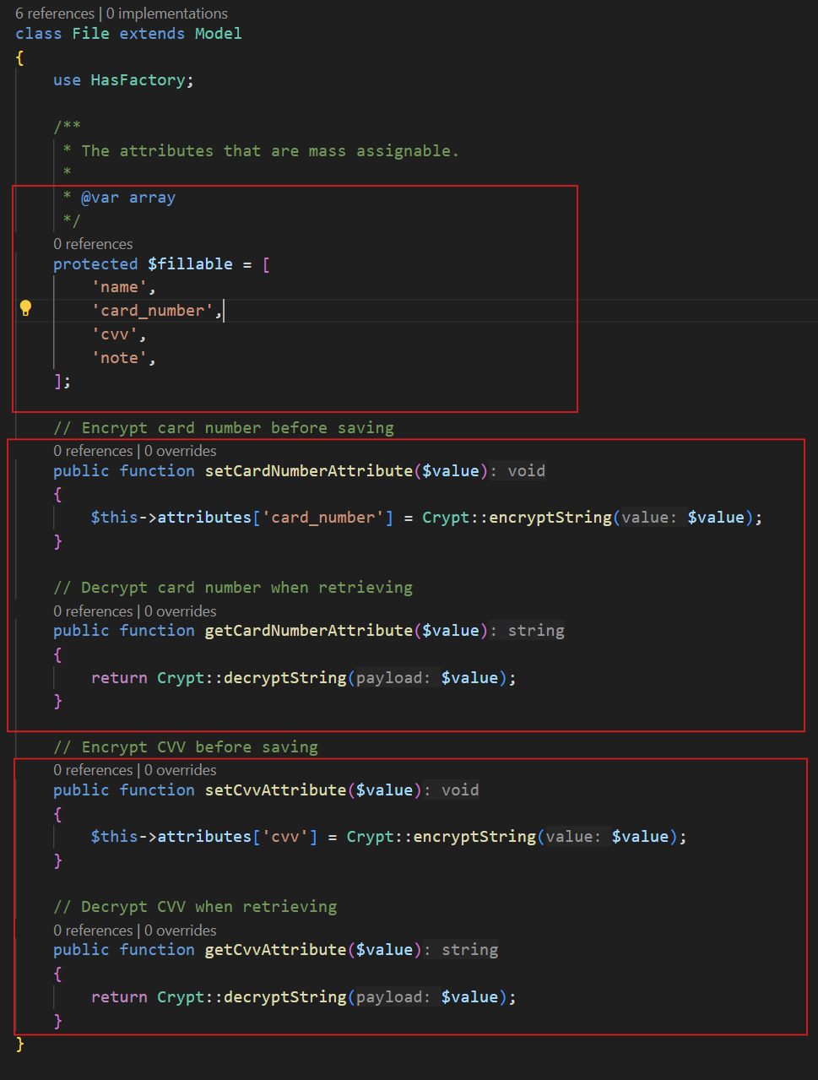
Source code: Model Class:

Slide 15
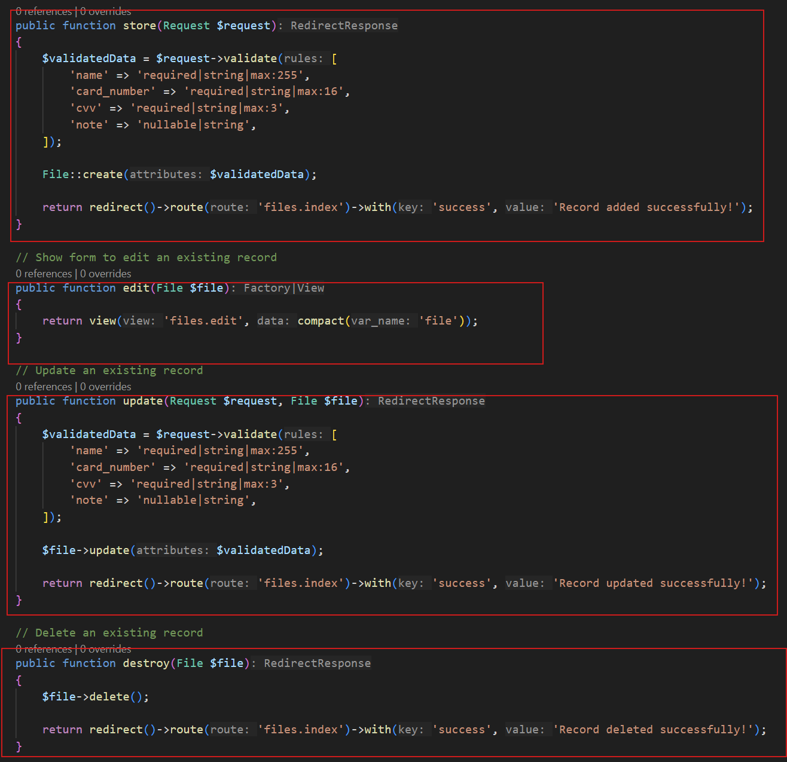
Controller Class:

Slide 16
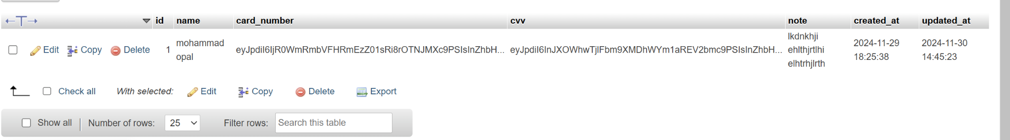
DB: File data table

Slide 17
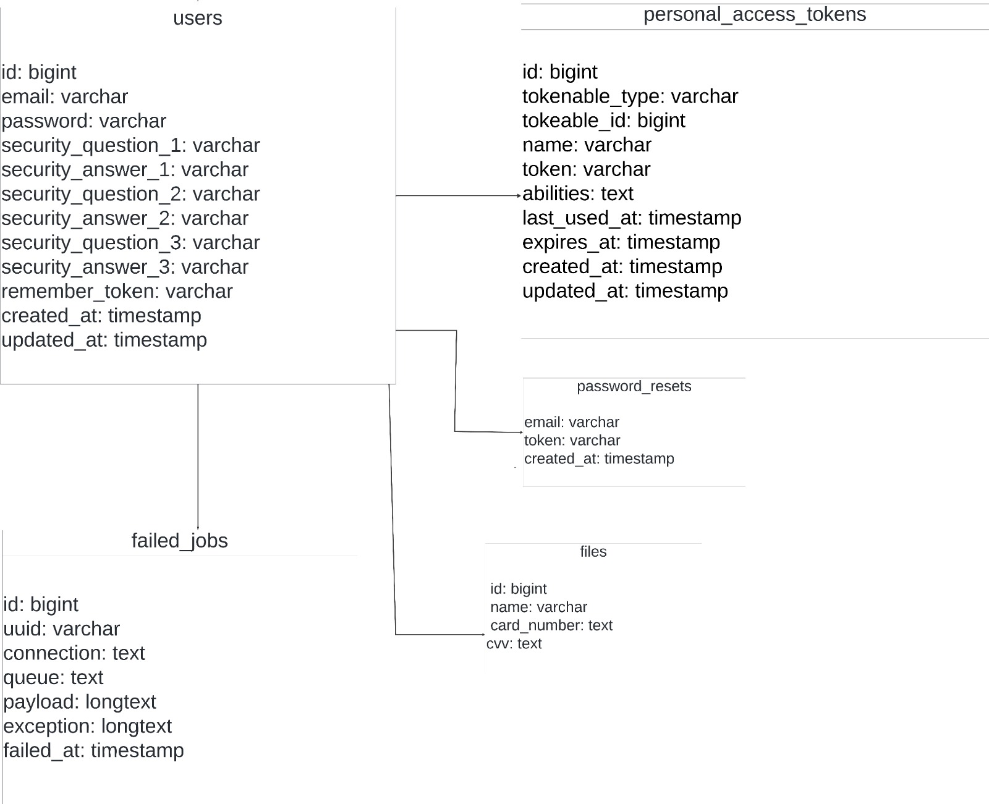
Class Diagram:

